Slide 1
Health & Safety, IT infrastructure Facilities Update Viv Hulme Trust Estates, Facilities, and IT Infrastructure Lead

Slide 2
Health and Safety at work act 1974
Section 2 – Employers have a duty to ensure as far as is reasonably practicable the health, safety and welfare of all employees
Section 7 – Employees have a duty to take reasonable care for the health and safety of themselves and of other persons who maybe affected by his acts or omission at work
Health & Safety is everybody's responsibility?

Slide 3
Health and Safety
Policies and documents can be found in the staff shared area – H&S policies and documents folder
COSHH safety – Control of Substances Hazardous to Health – see policy and know where Safety data sheets are kept/needed – if you order something with a Coshh label you must download the safety data sheet- send a copy to estates and keep a copy in the dept
General Risk Assessments - know where these are for your department
Lockdown procedure – covered in induction and on s drive with policies
Defibrillator – know where these are in your school usually the main office!
Speak to your line manager for more info

Slide 4
Fire Evacuation
Fire Safety – Please read the fire safety policy
Fire Drills take place each term – see Fire evacuation plan a copy of which is on display in the staff room.
On hearing the fire bell, please calmly take students with you and exit the building via nearest fire exit
Make your way to the Assembly point as detailed in your schools evacuation plan.
Instruct Students to line up as per plan quietly and calmly
Admin Staff will take registers/Sign in records out, follow plan to complete registration. Await further direction from SMT

Slide 5
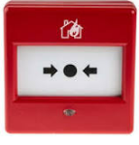
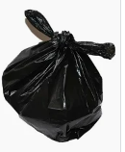
FIRE – Points to Note
Keep Fire Exits Clear
Break glass in case of fire located at external exits
Keep fire doors shut
Good Housekeeping reduces the risk of fire

Slide 6
If you discover a fire, press a fire alarm call point
They are normally placed in exits, landings, fire escapes or near areas of high risk

Slide 7
Health & Safety
Staff Handbook is located on Sharepoint Staff resources – First Day Pack along with other useful info
Staff Lanyards Green/Red – Non DBS – must be supervised, Yellow – DBS clear supervision not needed
Visitors must sign in and out and wear a visitor’s badge
Let reception know in advance if you are expecting visitors – DBS info the day prior to arrival
Remind visitors they will need to bring photo ID
Always remember to sign in and out; this is a requirement in school holidays also

Slide 8
Asbestos Containing Materials
Asbestos is present in 86% of schools, a register detailing where it is in your school is held on reception
It is perfectly safe so long as it is not disturbed and well managed
As a school we check it monthly to make sure there isn’t any damage, and annually by a licenced Asbestos contractor
Asbestos is identified by the following label
How can you help ? – do not knock nails into walls or lift ceiling tiles without checking with estates first
Report any damage/concerns immediately to the Asbestos duty holder – usually the Headteacher as detailed in Management plan or to the Estates Lead

Slide 9
Working at Height
Ladder training must be completed before you can use a ladder

Slide 10
IT Infrastructure
Update regarding GDPR and Data Protection sent out regularly it is important you read these
IT Team – Tim Clayden contact details below for support
Telford & Wrekin IT Helpdesk ticket system – ICT Self Service
Cyber Security, KCSIE changes for 2023 includes updates to filtering and monitoring standards – we are reviewing and will send out updates
Summer works:
Installed new interactive boards into rooms 19 & 21 - Lacon
Increased WIFI access points from 22-42 to improve coverage - Lacon
Staff laptops – Trust wide
Future
Lots to consider which include, replacement phones, looking at internet speed, impact of Windows 11
Tim.Clayden@taw.org.uk​

Slide 11
Health and Safety
Accidents / Injuries/Near Miss
All accidents/injuries/near misses need to be recorded
What is a near Miss?
A Near Miss is an unplanned event that
did not result in injury, illness, or
damage – but had the potential to do so

Slide 12
Recycling

Slide 13
Energy
Utility Bills have increased significantly over the last year
We need to look at savings where we can
Do not leave lights on when the room is empty
Do not switch heaters on full then open windows/doors as its too hot
Make sure heaters are switched off over the weekend

Slide 14
Trust Estates Team
Team – Colin, Pete & Martin
Worked hard all summer to ensure school is ready for the new term
Estates team help desk info (estatesteam@laconchildeschool.co.uk)​
Viv.hulme@laconchildeschool.co.uk
Look out for future updates to move this to repairs and maintenance via PARAGO​

Slide 15
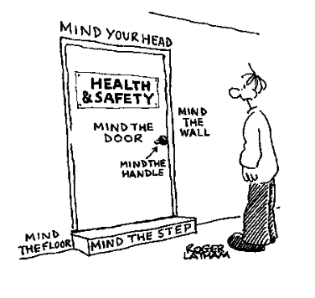
Health & Safety
If you have issues or concerns regarding health and safety – please contact me – thank you for listening.

